Slide 1
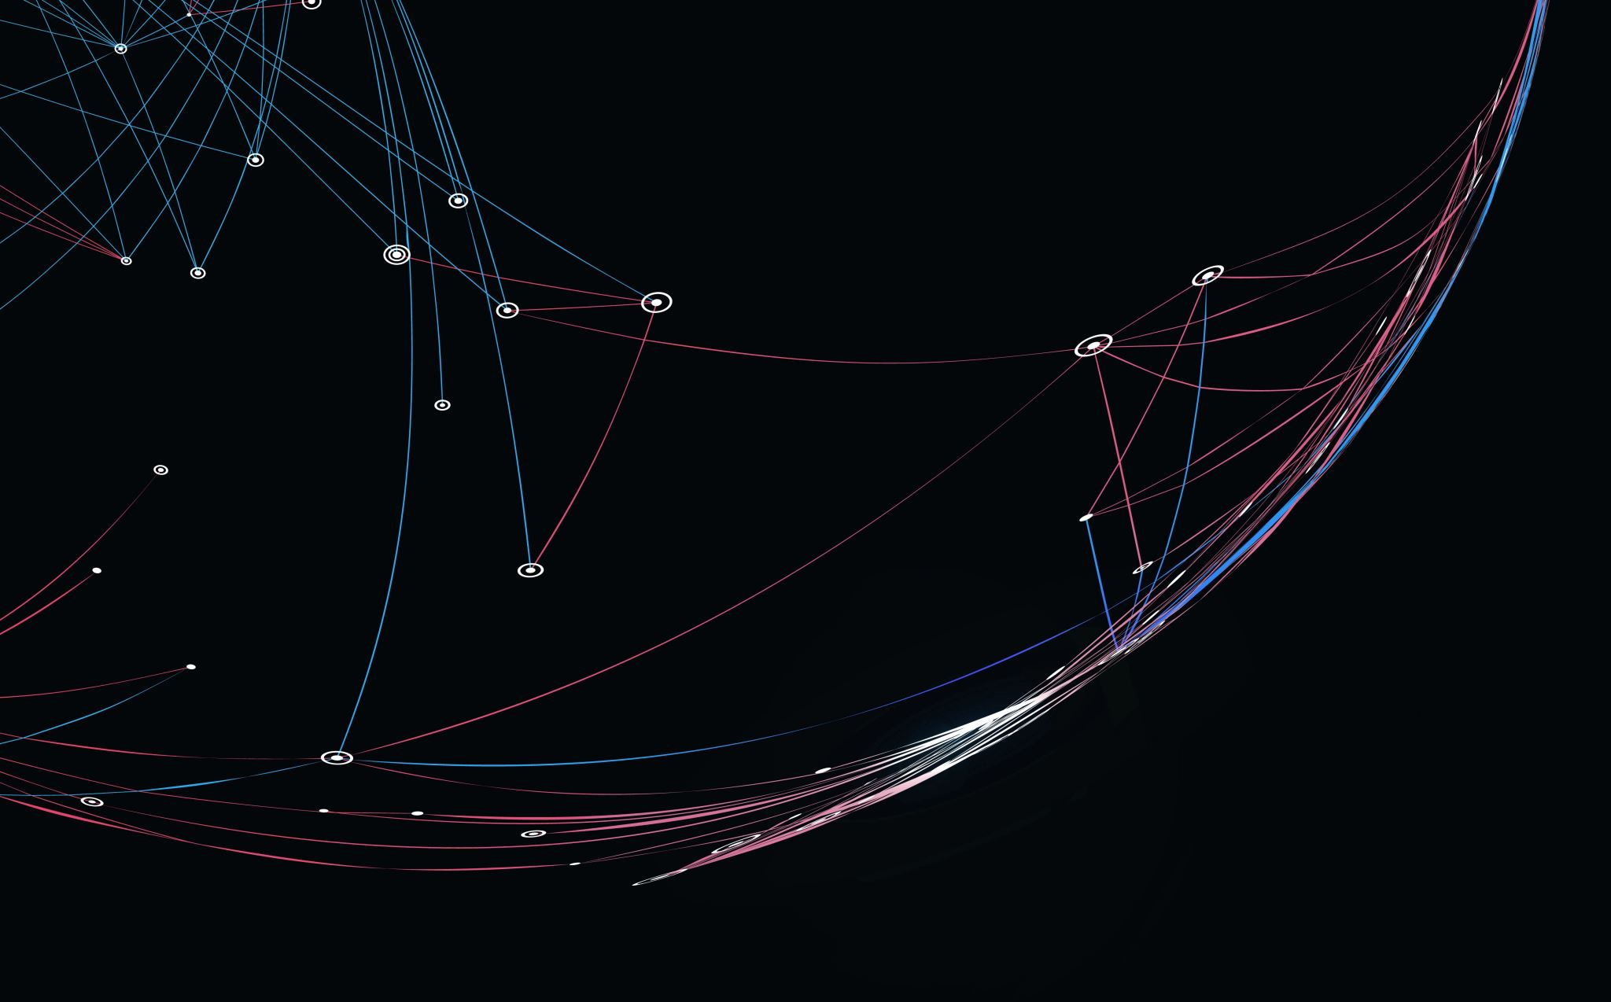
RC simulation Based on Unreal through the Arduino
A.U.J. Dissanayake
20191143
W1790013

Slide 2
Content
Problem Domain
Research Gap
Research Aim
Design
Implementation
Demonstration
Testing and Evaluation
Future Enchantment
Conclusion

Slide 3


Problem Domain
Heading online competition instead of physical.

Slide 4
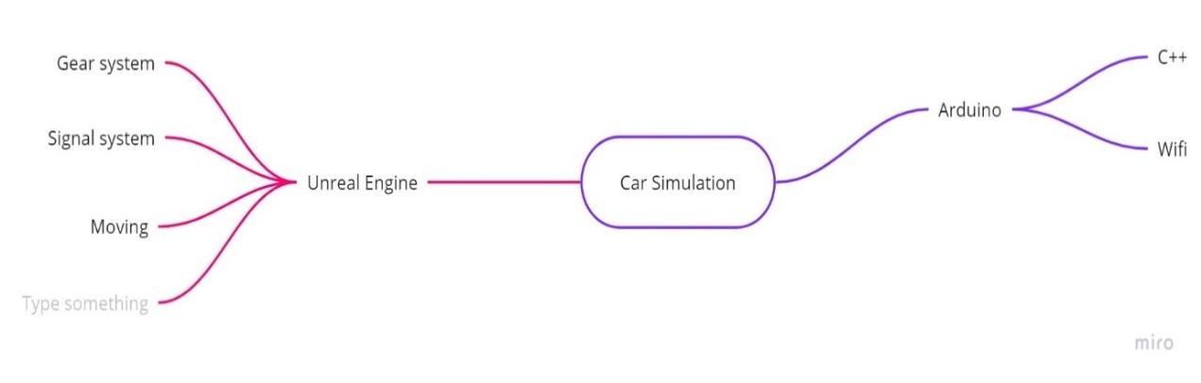
Research Gap
Unreal Engine game for RC cars.

Slide 5
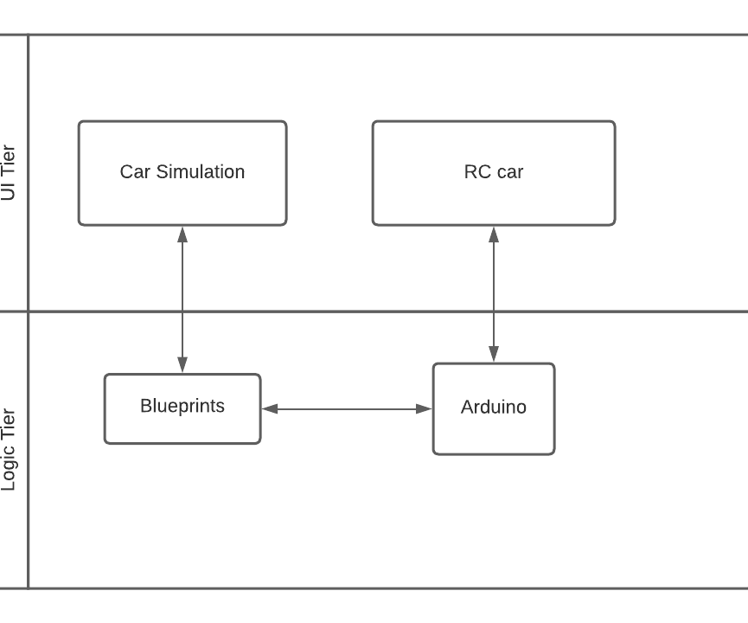
Design

Slide 6
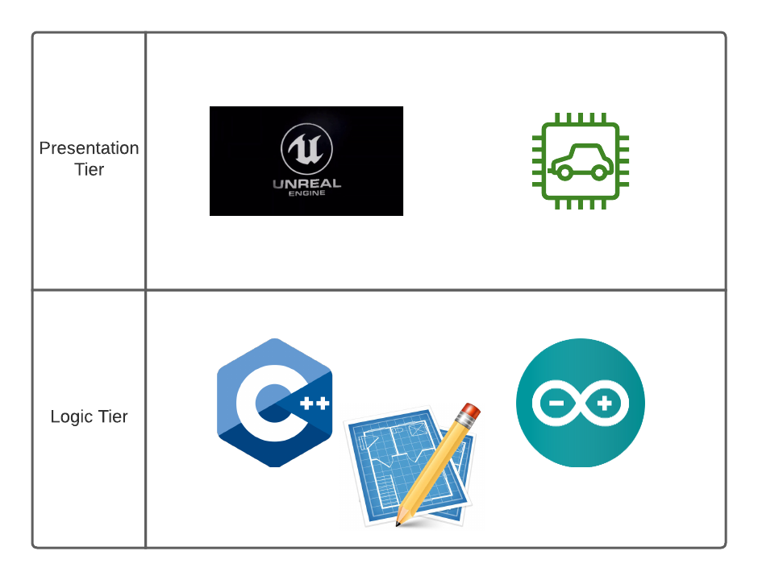
Implementation

Slide 7

Demonstration

Slide 8
Testing and Evaluation
Accuracy
Expenses
Limitation of researches
Computer Performance

Slide 9
Future Enchantment
Real Time Physics.
AI Powered Control.
Different vehicle types. (ex : Drones, Boats)
Real time vehicles.

Slide 10

Conclusion
New Skills – Serial Com plug-in
Esp32
Existing Skills – Unreal Blueprint
Unreal Animation
Arduino C++

Slide 11

Summary
Any Questions ?

